Slide 1
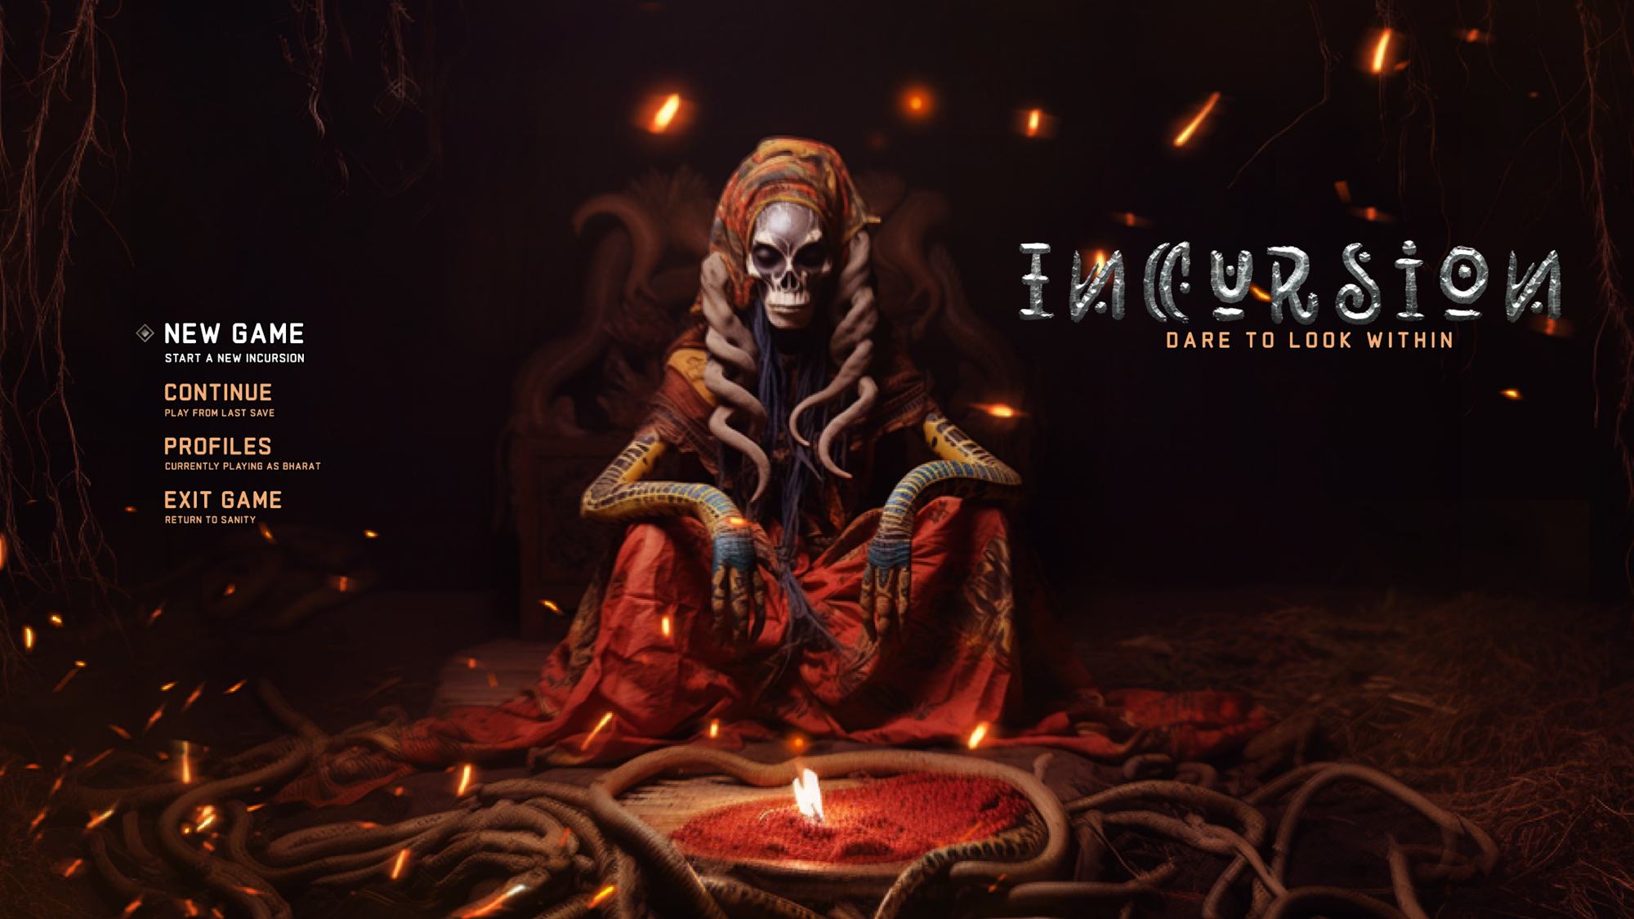

Slide 2
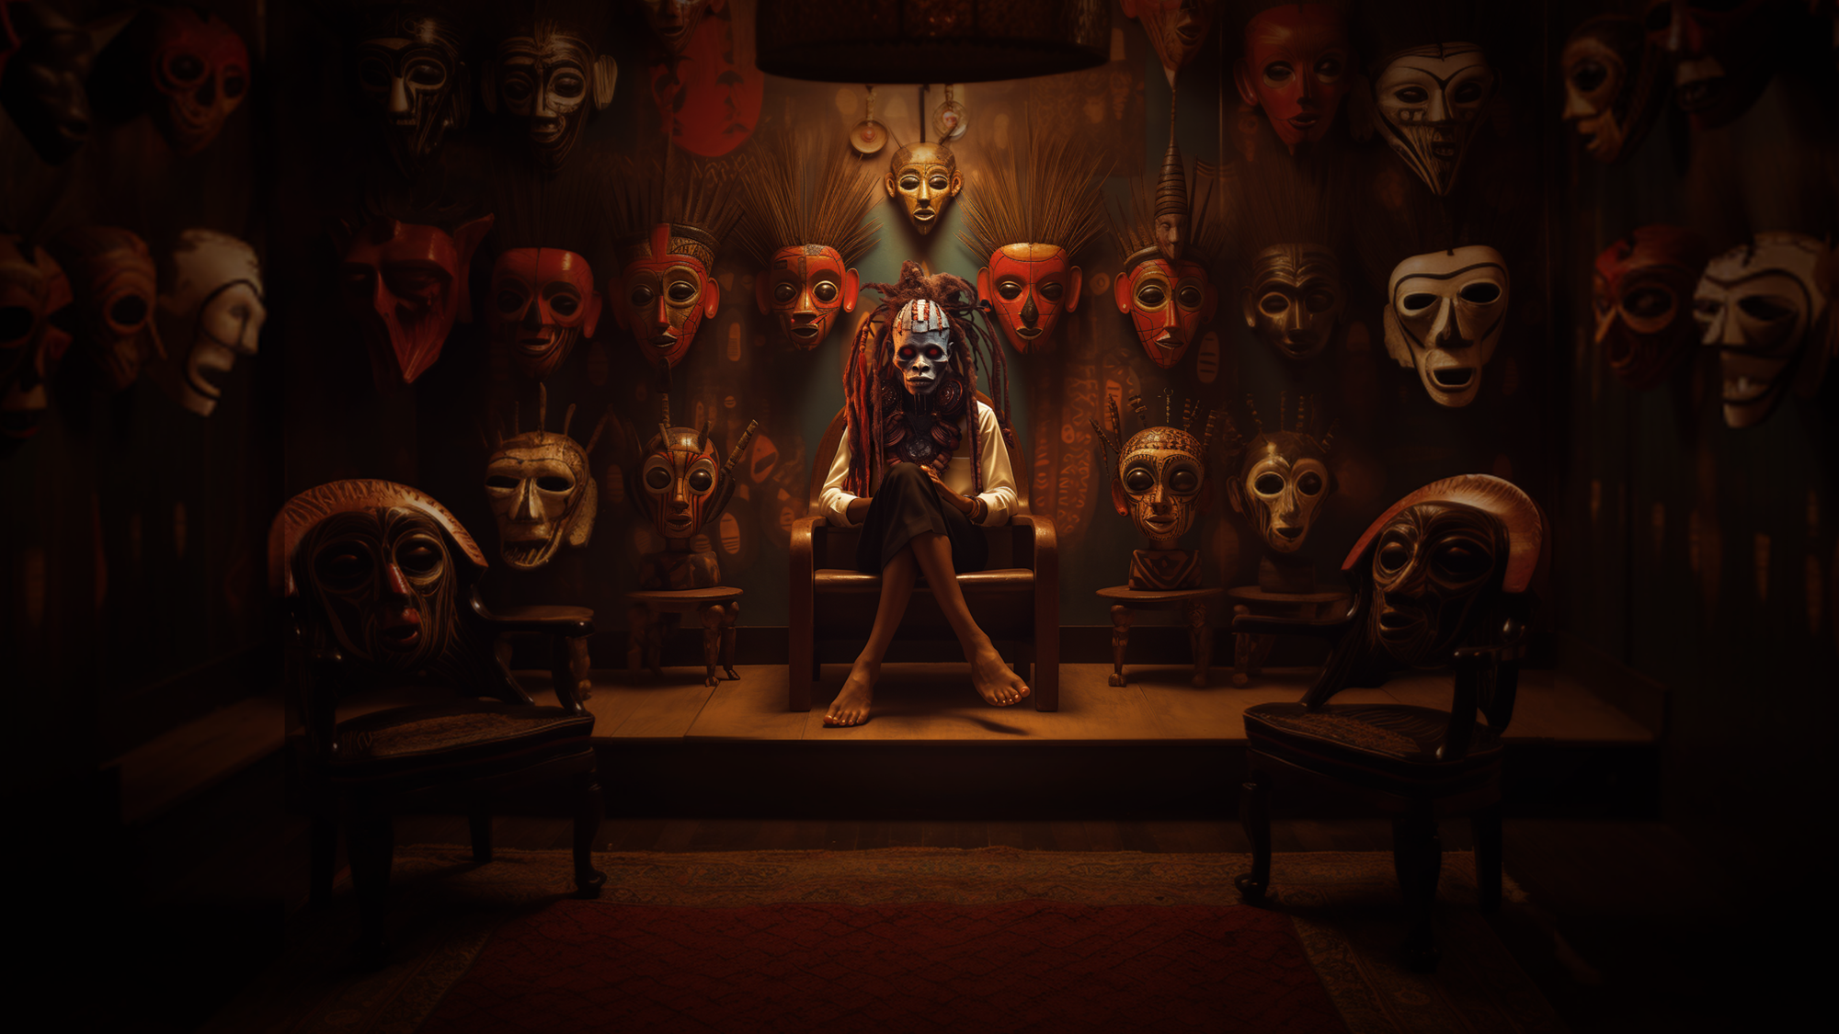
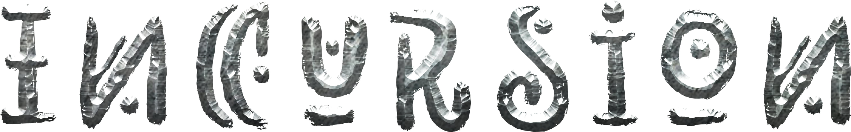

The experience
A psychological horror following the struggle of an African traditional healer who must invade dreams to solve a generational curse. Weave her emotions to craft items and create over 100 unique spells . Then pass them down to your next generation when death inevitably takes you.
TURN BASED
SPELL CRAFTING
The reward of well laid plans bearing fruit.
The dopamine rush of seeing your build kick ass
ROGUELIKE
The tension of seemingly irreversible choices
“Meet The Doctor” – Cutscene Concept

Slide 3
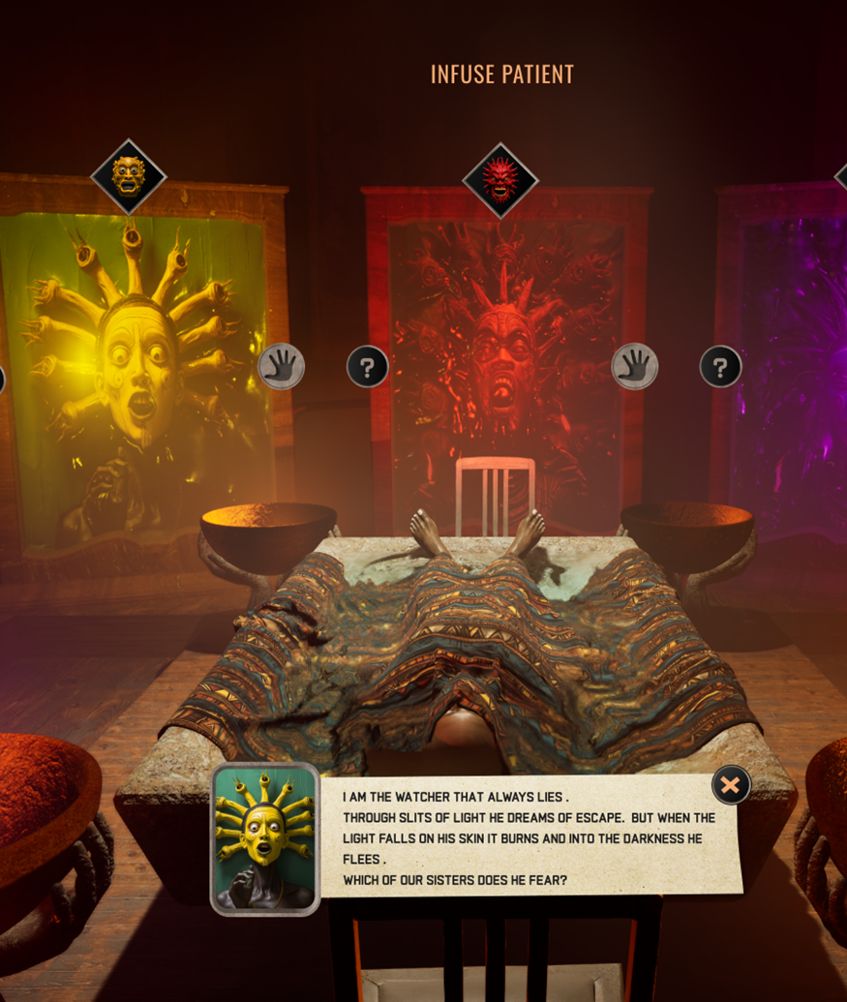
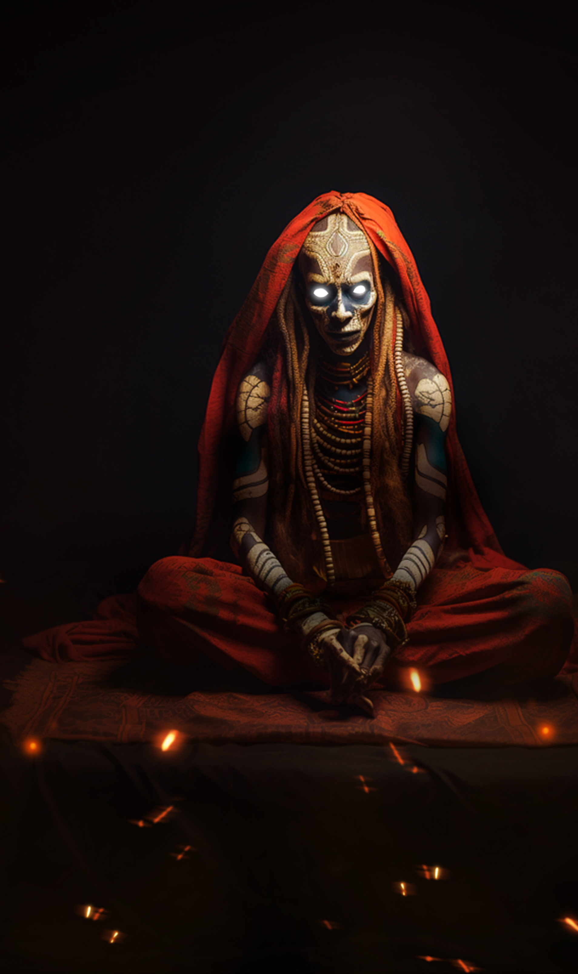
You play 'The Last Daughter,’ an healer whose dark alter ego, 'The First Mother,’ is awakening
Find a way to exorcise her by solving riddles that unlock the dreams of your patients
Lose control and ‘The First Mother’ will take over. Forcing a new generation to restart with your remains
“The Masks” – Character Prototypes
“Mother Awakes” – Character Concept
In game – placeholder UI

Slide 4
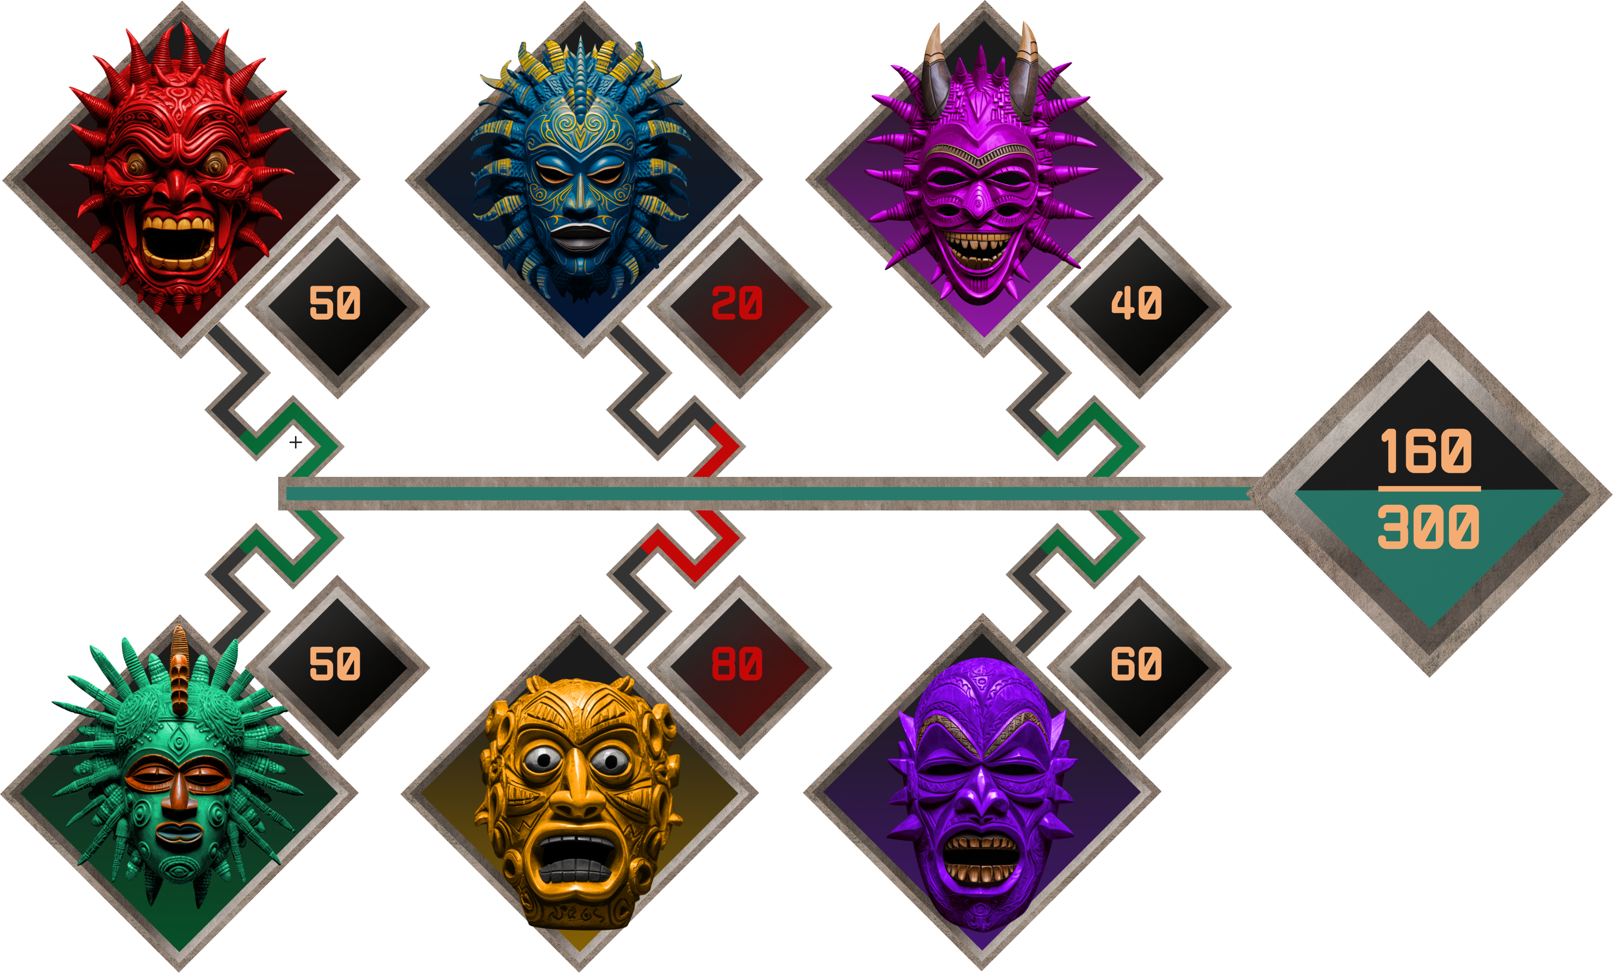
Center Yourself Or Lose it All
Cross the 100 / 0 threshold and lose sanity
Balance opposing pairs of emotional states
Higher value = ++ damage & ++ debuff
Rage vs Apathy
Lower value = ++ resist & ++ heals
Resolve vs Doubt
Obsession vs Revulsion
Value of item enchantments
They increase whenever used for any ability or action
Available Dialogue Choices
0 sanity spawns final boss

Slide 5
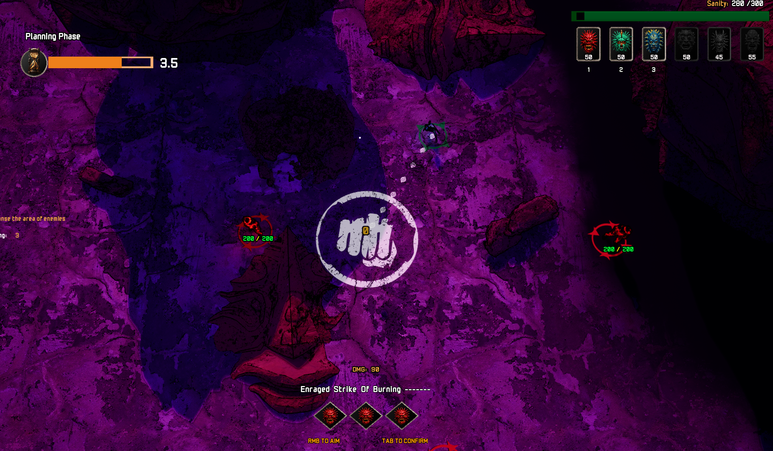
During your incursion combat turns happen simultaneously with your enemies
Preview enemy actions to accurately plan moves
Build your spells on the fly activating modifiers from crafted items
In game – placeholder character models, VFX and UI

Slide 6
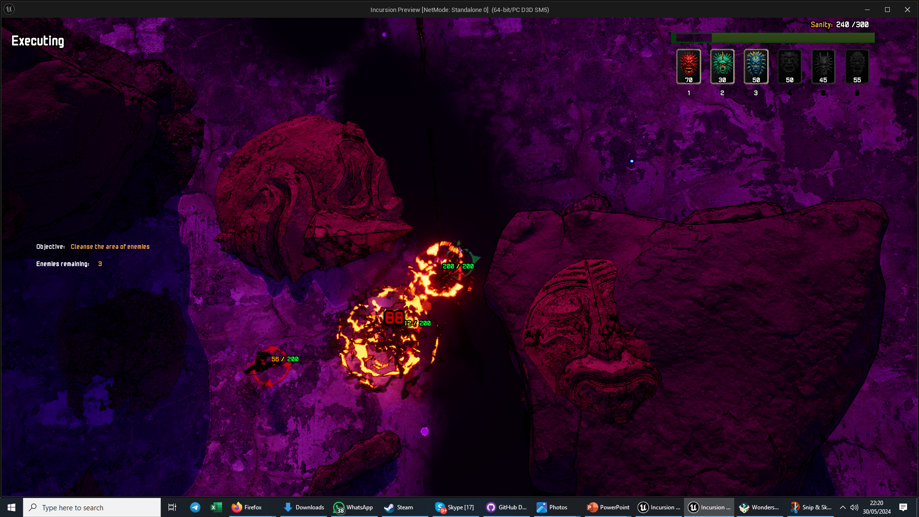
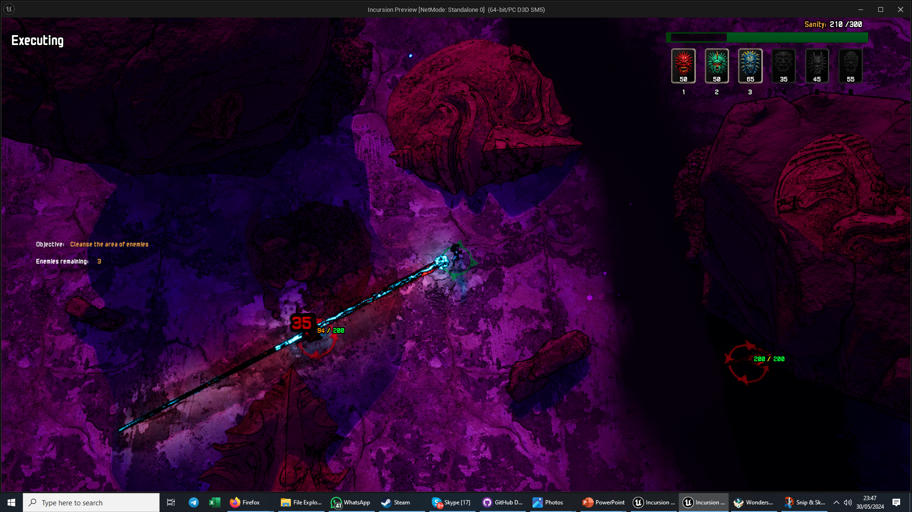
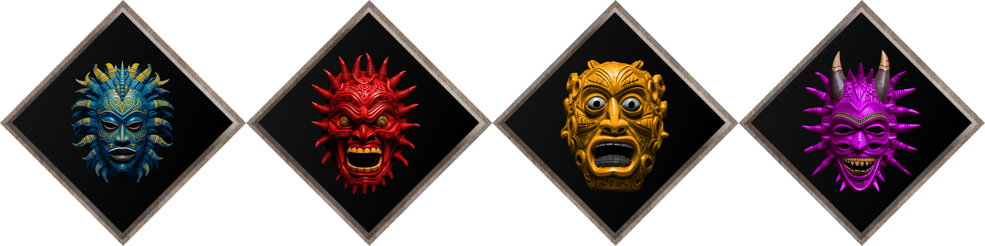
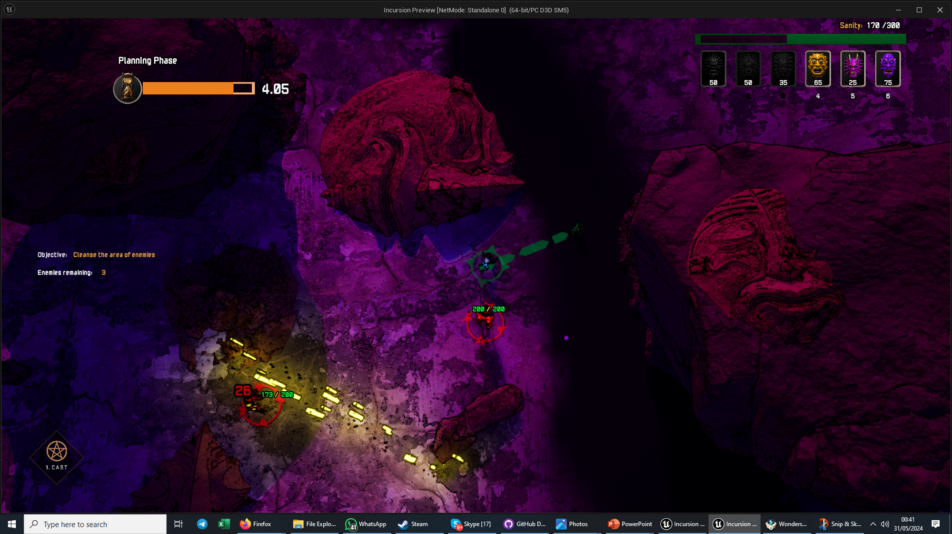
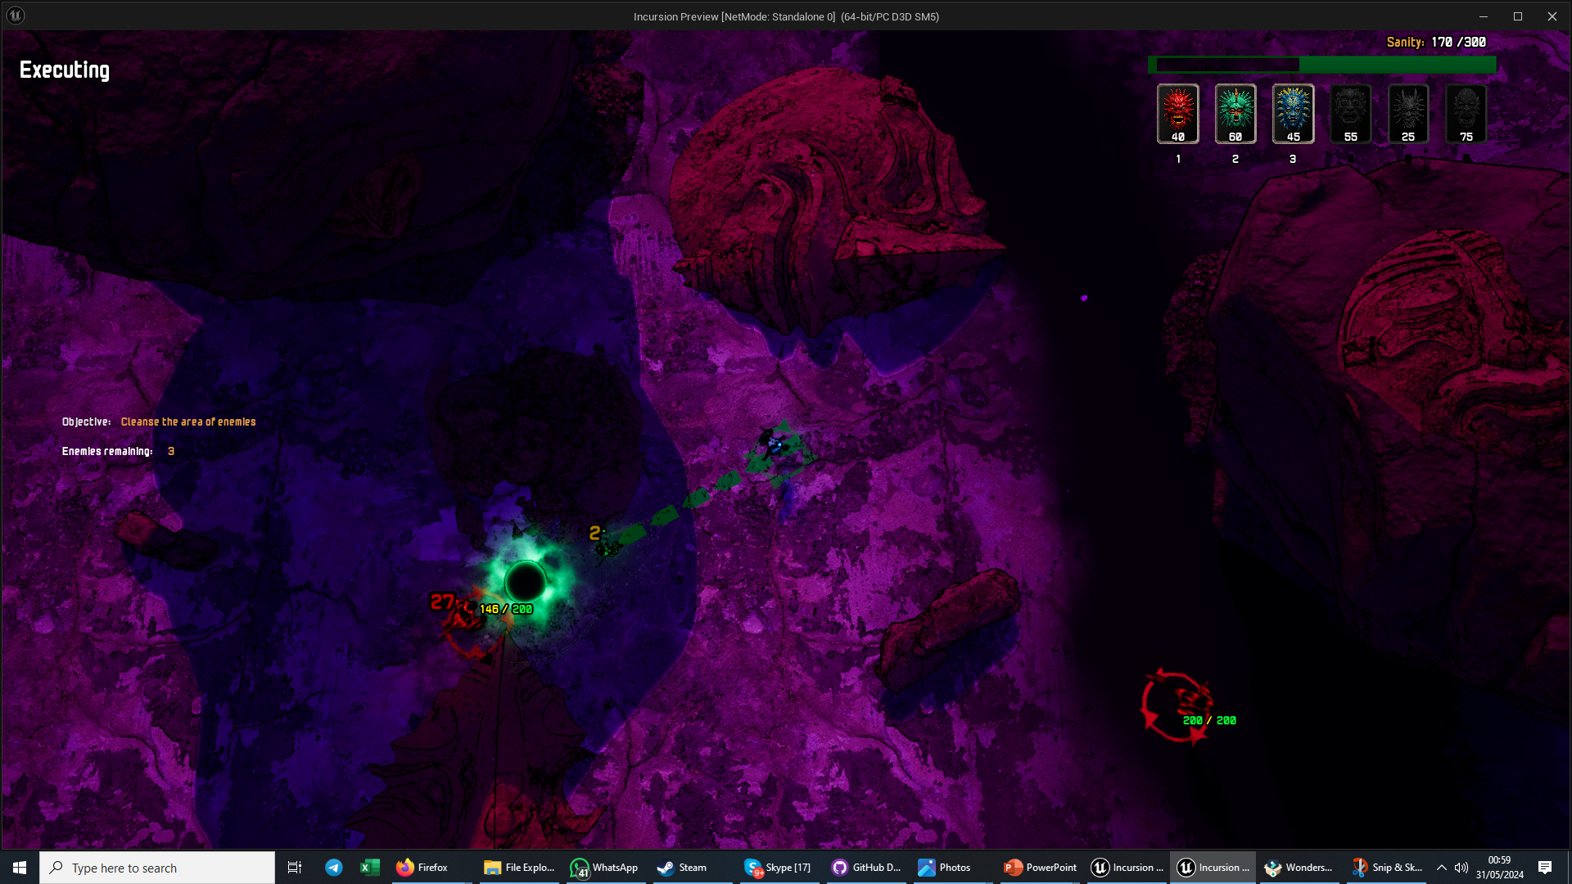
A beam of courage that strips armor
An explosion of rage that resurrects dead
6
emotions
Damage
Shape
Debuff
Summon
4
affixes
4
item mods
In the dreamworld plan your plan your moves carefully ahead of their execution
Build your spells on the fly activating modifiers from crafted items
Your turn happens simultaneously with the enemy after planning
Mask
Wristbands
Necklace
Shoes
+120
CUSTOMISABLE
COMBOS
A wall of panic that drains health
A vortex of apathy that slows

Slide 7


Continuous Progression
Solve Incursions
Pass on a memory (quest, items)
Earn resources
Start new run
The Run
Rebirth
Meta Game
Craft + upgrade items and affixes
Select a memory to use
Challenge mini bosses
The Big Bad

